Slide 1

Session 7
Bachelors degree in bioinformatics
CLUSTERING METHODS AND ALGORITHMS IN GENOMICS AND EVOLUTION
Distance based methods for tree inference
Course 2023-2024

Slide 2
Outline
Transforming Distance Matrices into Evolutionary Trees
Toward an Algorithm for Distance-Based Phylogeny Construction
Additive Phylogeny
Ultrametric Evolutionary Trees (UPGMA reconstruction)
The Neibour-Joining Algorithm
Using Least-Squares to construct Distance-Based Phylogenies

Slide 3
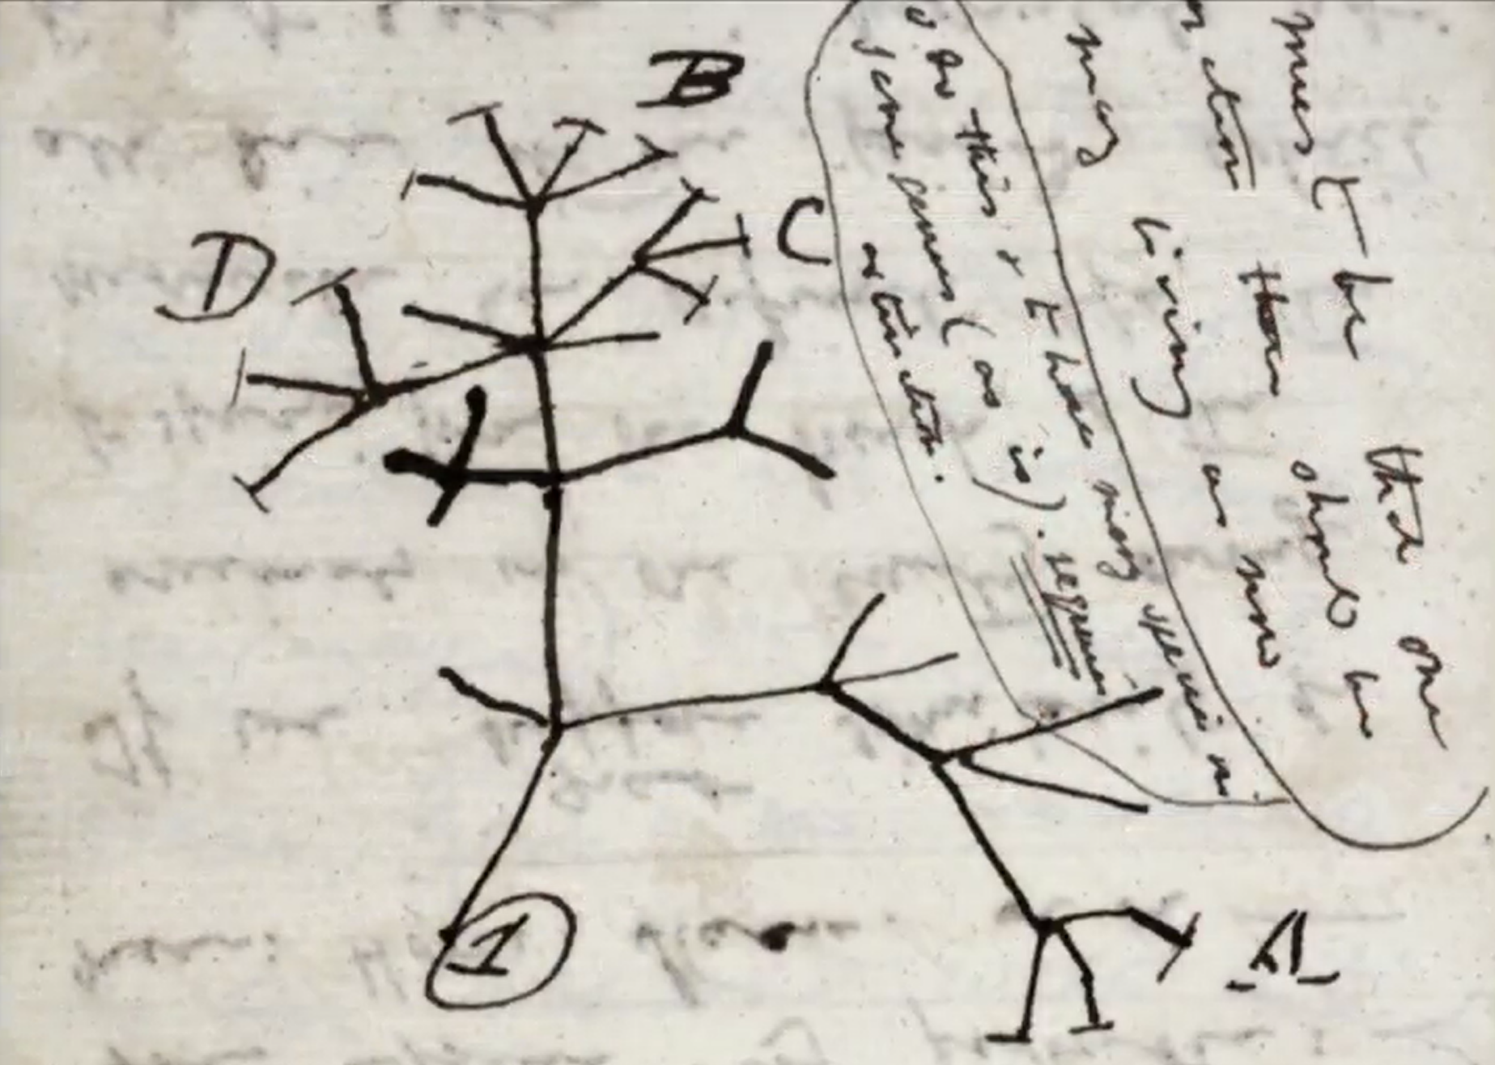
First evolutionary tree drawn by Charles Darwin in 1837.

Slide 4
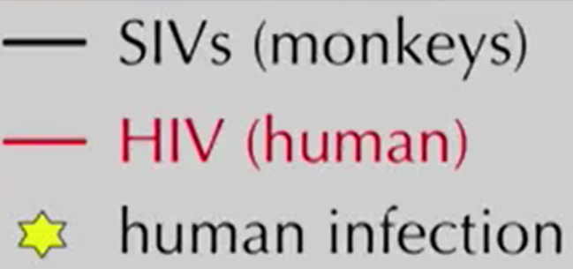
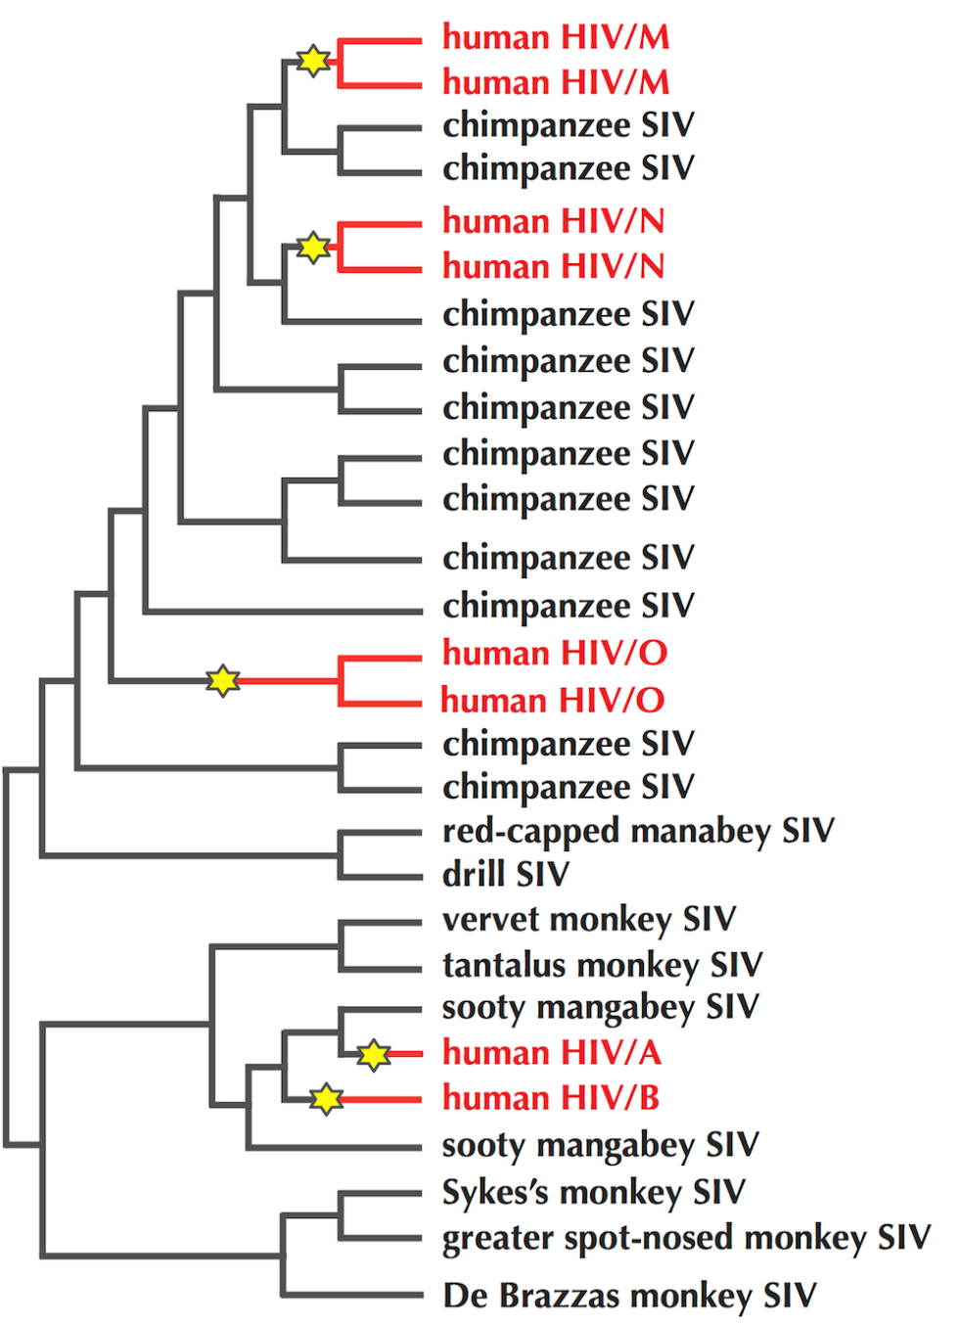
Example: HIV Evolutionary Tree
HIV comprises five different viral families, denoted as A, B, M, N, and O, with the M family responsible for 95% of all HIV infections.
The five families are different offshoots of the evolutionary tree for Simian Immunodeficiency Virus (SIV), which infects primates.
Stars indicate viruses transitioning from primates to humans. The A and B families originated in sooty mangabey monkeys, whereas the M, N, and O families originated in chimpanzees.
If we want to know which animal gave us SARS we should construct an evolutionary tree for the SARS coronovirus as well.

Slide 5
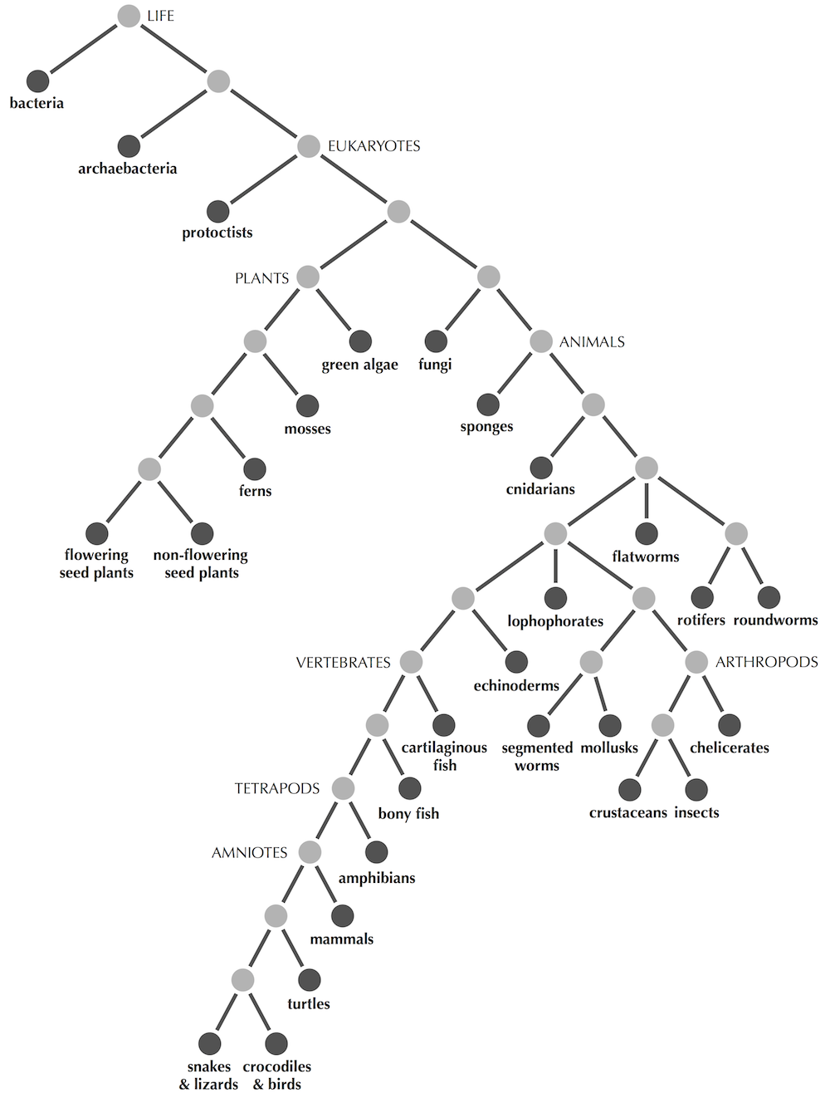
Trees
Tree: Connected graph containing no cycles.
Connected: the tree holds in one piece.
Acyclic: the tree can branch out without growing back in on itself and forming a cycle.
A connected graph without cycles that models an evolutionary tree of life on Earth. Present-day species are shown as darker nodes.

Slide 6
Trees
Tree: Connected graph containing no cycles.
Leaves (degree = 1): present-day species.
Should be at the ending nodes of the tree.
Degree- a number of edges connecting a node to other nodes.
A connected graph without cycles that models an evolutionary tree of life on Earth. Present-day species are shown as darker nodes.

Slide 7
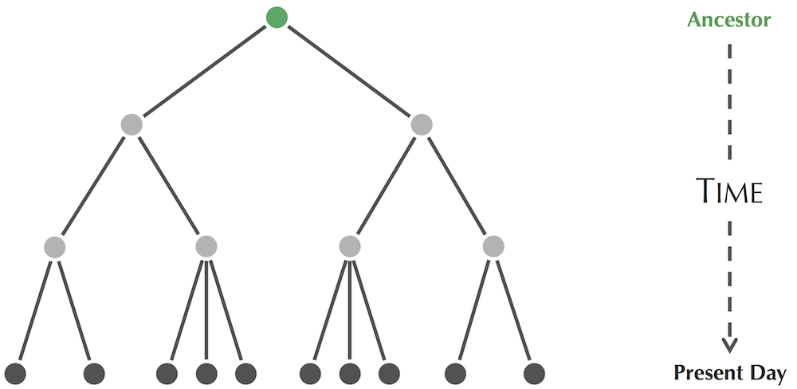
Trees
A rooted tree, with the root (representing an ancestor of all species in the tree) indicated in green at the top of the tree. The presence of the root implies an orientation of edges in the tree away from the root such that time flows downward from the root to the leaves in the sense that each edge of the tree connects an older species to a more recent species.
Rooted tree: one node is designated as the root (most recent common ancestor)

Slide 8
Outline
Transforming Distance Matrices into Evolutionary Trees
Toward an Algorithm for Distance-Based Phylogeny Construction
Additive Phylogeny
Ultrametric Evolutionary Trees (UPGMA reconstruction)
The Neibour-Joining Algorithm
Using Least-Squares to construct Distance-Based Phylogenies

Slide 9
Constructing a Distance Matrix
Species | Alignment
Chimp | ACGTAGGCCT
Human | ATGTAAGACT
Seal | TCGAGAGCAC
Whale | TCGAAAGCAT
A toy multiple alignment of hypothetical DNA sequences from four species…

Slide 10
Constructing a Distance Matrix
D_{i,j} = number of differing symbols between i-th and j-th rows of a multiple alignment.
Species | Alignment | Distance Matrix (D)
 |  | Chimp | Human | Seal | Whale
Chimp | ACGTAGGCCT | 0 | 3 | 6 | 4
Human | ATGTAAGACT | 3 | 0 | 7 | 5
Seal | TCGAGAGCAC | 6 | 7 | 0 | 2
Whale | TCGAAAGCAT | 4 | 5 | 2 | 0
A multiple alignment of hypothetical DNA sequences from four species, along with the distance matrix produced by counting the number of differing symbols between each pair of rows in this multiple alignment.

Slide 11
Constructing a Distance Matrix
D_{i,j} = number of differing symbols between i-th and j-th rows of a multiple alignment.
Species | Alignment | Distance Matrix (D)
 |  | Chimp | Human | Seal | Whale
Chimp | ACGTAGGCCT | 0 | 3 (D_{2,1}) | 6 | 4
Human | ATGTAAGACT | 3 (D_{1,2}) | 0 | 7 | 5
Seal | TCGAGAGCAC | 6 | 7 | 0 | 2
Whale | TCGAAAGCAT | 4 | 5 | 2 | 0
D_{1,2} = D_{2,1} = 3
A multiple alignment of hypothetical DNA sequences from four species, along with the distance matrix produced by counting the number of differing symbols between each pair of rows in this multiple alignment.

Slide 12
Constructing a Distance Matrix
D_{i,j} = number of differing symbols between i-th and j-th rows of a multiple alignment.
Species | Alignment | Distance Matrix (D)
 |  | Chimp | Human | Seal | Whale
Chimp | ACGTAGGCCT | 0 | 3 | 6 | 4
Human | ATGTAAGACT | 3 | 0 | 7 | 5
Seal | TCGAGAGCAC | 6 | 7 | 0 | 2
Whale | TCGAAAGCAT | 4 | 5 | 2 | 0
Regardless of which distance function we use, in order to be a distance matrix, D must satisfy three properties. It must be symmetric (for all i and j, D_{i,j} = D_{j,i}), non-negative (for all i and j, D_{i,j} ≥ 0) and satisfy the triangle inequality (for all i, j, and k, D_{i,j} + D_{j,k} ≥ D_{i,k} ), where k is any third species.

Slide 13
Fitting a Tree to a Matrix
 | Chimp | Human | Seal | Whale
Chimp | 0 | 3 | 6 | 4
Human | 3 | 0 | 7 | 5
Seal | 6 | 7 | 0 | 2
Whale | 4 | 5 | 2 | 0
The toy distance matrix constructed from a multiple alignment.

Slide 14
Fitting a Tree to a Matrix
 | Chimp | Human | Seal | Whale
Chimp | 0 | 3 | 6 | 4
Human | 3 | 0 | 7 | 5
Seal | 6 | 7 | 0 | 2
Whale | 4 | 5 | 2 | 0
Chimp
1
2
Seal
3
Human
2
0
Whale
Unrooted tree fitting the distance matrix.

Slide 15
Fitting a Tree to a Matrix
 | Chimp | Human | Seal | Whale
Chimp | 0 | 3 | 6 | 4
Human | 3 | 0 | 7 | 5
Seal | 6 | 7 | 0 | 2
Whale | 4 | 5 | 2 | 0
Deriving an unrooted tree from a distance matrix:
The leaves of this tree should correspond to the species represented by the matrix.
Assign each edge a non-negative length representing the evolutionary distance between the organisms that the edge connects.
Chimp
1
2
Seal
3
Human
2
0
Whale
Unrooted tree fitting the distance matrix.

Slide 16
Fitting a Tree to a Matrix
 | Chimp | Human | Seal | Whale
Chimp | 0 | 3 | 6 | 4
Human | 3 | 0 | 7 | 5
Seal | 6 | 7 | 0 | 2
Whale | 4 | 5 | 2 | 0
Chimp
1
2
Seal
3
Human
2
0
Whale
Unrooted tree fitting the distance matrix.
We will need to assign weights to the edges of this tree so that the sum of weights along a path that connects two leaves corresponds to the distance matrix value for those two leaves.

Slide 17
Distance-Based Phylogeny Problem
Distance-Based Phylogeny Problem: Construct an evolutionary tree from a distance matrix.
Input: A distance matrix.
Output: The unrooted tree “fitting” this distance matrix.
STOP and Think: Does the Distance-Based Phylogeny Problem always have a solution?

Slide 18
Return to Distance-Based Phylogeny
Exercise Break: Try fitting a tree to the following matrix.
 | i | j | k | l
i | 0 | 3 | 4 | 3
j | 3 | 0 | 4 | 5
k | 4 | 4 | 0 | 2
l | 3 | 5 | 2 | 0

Slide 19
More than one Tree fits a matrix
 | Chimp | Human | Seal | Whale
Chimp | 0 | 3 | 6 | 4
Human | 3 | 0 | 7 | 5
Seal | 6 | 7 | 0 | 2
Whale | 4 | 5 | 2 | 0
0.5
Seal
Chimp
1
1.5
3
1
0
Whale
Human
1
We simply stretch out the edges of the tree we had before into longer paths and still have a tree that fits the distance matrix.

Slide 20
Which Tree is “Better”?
Chimp
1
2
Seal
3
Human
2
0
Whale
0.5
Seal
Chimp
1
1.5
3
1
0
Whale
Human
1

Slide 21
Outline
Transforming Distance Matrices into Evolutionary Trees
Toward an Algorithm for Distance-Based Phylogeny Construction
Additive Phylogeny
Ultrametric Evolutionary Trees (UPGMA reconstruction)
The Neibour-Joining Algorithm
Using Least-Squares to construct Distance-Based Phylogenies

Slide 22
An Idea of Distance-Based Phylogeny
 | Chimp | Human | Seal | Whale
Chimp | 0 | 3 | 6 | 4
Human | 3 | 0 | 7 | 5
Seal | 6 | 7 | 0 | 2
Whale | 4 | 5 | 2 | 0
Chimp
1
2
Seal
3
Human
2
0
Whale
The minimum element of this matrix corresponds to two leaves that are next to each other on the tree.

Slide 23
An Idea of Distance-Based Phylogeny
 | Chimp | Human | Seal | Whale
Chimp | 0 | 3 | 6 | 4
Human | 3 | 0 | 7 | 5
Seal | 6 | 7 | 0 | 2
Whale | 4 | 5 | 2 | 0
?
Seal
?
Whale
Let’s pretend that we don’t know the tree that fits the distance matrix, and see if we can use the fact, that seal and whale are neighbors in order to reconstruct the tree.

Slide 24
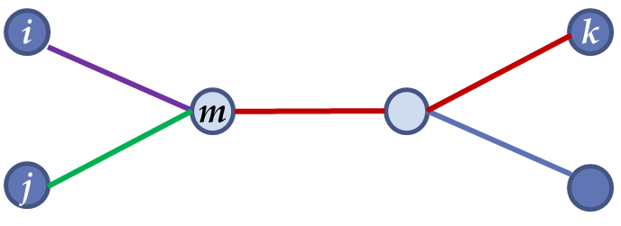
Toward a Recursive Algorithm
d_{i,m}
d_{k,m}
d_{j,m}
A tree with neighboring leaves i and j that share a parent m. We try to reconstruct the green and purple distances. But if k is some other leaf in the tree, the red distance will help us out.

Slide 25
Toward a Recursive Algorithm
d_{i,k} = d_{i,m} + d_{k,m}
d_{i,j} = d_{i,m} + d_{j,m}
d_{j,k} = d_{j,m} + d_{k,m}

Slide 26
Toward a Recursive Algorithm
d_{i,k} = d_{i,m} + d_{k,m}
d_{i,j} = d_{i,m} + d_{j,m}
d_{j,k} = d_{j,m} + d_{k,m}
d_{k,m} = [(d_{i,m} + d_{k,m}) + (d_{j,m} + d_{k,m}) - (d_{i,m} + d_{j,m})] / 2
d_{k,m} = (d_{i,k} + d_{j,k} - d_{i,j})/ 2
If it is known that i and j are neighbors, we can compute the distance from them to their parent, just from the distance matrix alone.
d_{k,m} = (D_{i,k} + D_{j,k} - D_{i,j})/ 2
d_{i,m} = (D_{i,k} + D_{i,j} - D_{j,k})/ 2
d_{j,m} = (D_{j,k} + D_{i,j} - D_{i,k})/ 2

Slide 27
An Idea of Distance-Based Phylogeny
 | Chimp | Human | Seal | Whale
Chimp | 0 | 3 | 6 | 4
Human | 3 | 0 | 7 | 5
Seal | 6 | 7 | 0 | 2
Whale | 4 | 5 | 2 | 0
?
Seal
?
Whale
d_{i,m} = (D_{i,k} + D_{i,j} - D_{j,k})/ 2

Slide 28
An Idea of Distance-Based Phylogeny
 | Chimp | Human | Seal | Whale
Chimp | 0 | 3 | 6 | 4
Human | 3 | 0 | 7 | 5
Seal | 6 | 7 | 0 | 2
Whale | 4 | 5 | 2 | 0
Chimp
d_{Seal,m}
Seal
m
?
Whale
d_{Seal,m} = (D_{Seal,Chimp} + D_{Seal,Whale} - D_{Whale,Chimp})/ 2

Slide 29
An Idea of Distance-Based Phylogeny
 | Chimp | Human | Seal | Whale
Chimp | 0 | 3 | 6 | 4
Human | 3 | 0 | 7 | 5
Seal | 6 | 7 | 0 | 2
Whale | 4 | 5 | 2 | 0
Chimp
2
Seal
m
?
Whale
d_{Seal,m} = 2

Slide 30
An Idea of Distance-Based Phylogeny
 | Chimp | Human | Seal | Whale
Chimp | 0 | 3 | 6 | 4
Human | 3 | 0 | 7 | 5
Seal | 6 | 7 | 0 | 2
Whale | 4 | 5 | 2 | 0
Chimp
4
2
Seal
m
Human
5
0
Whale

Slide 31
An Idea of Distance-Based Phylogeny
 | Chimp | Human | Seal | Whale | m
Chimp | 0 | 3 | 6 | 4 | 4
Human | 3 | 0 | 7 | 5 | 5
Seal | 6 | 7 | 0 | 2 | 2
Whale | 4 | 5 | 2 | 0 | 0
m | 4 | 5 | 2 | 0 | 0
Chimp
4
2
Seal
m
Human
5
0
Whale

Slide 32
An Idea of Distance-Based Phylogeny
 | Chimp | Human | m
Chimp | 0 | 3 | 4
Human | 3 | 0 | 5
m | 4 | 5 | 0
Getting rid of Seal and Whale entirely yields a smaller 3x3 matrix.
Chimp
4
2
Seal
m
Human
5
0
Whale

Slide 33
An Idea of Distance-Based Phylogeny
 | Chimp | Human | m
Chimp | 0 | 3 | 4
Human | 3 | 0 | 5
m | 4 | 5 | 0
Chimp
?
2
Seal
a
m
Human
?
0
Whale
d_{Chimp,a} = (D_{Chimp,m} + D_{Chimp,Human} - D_{Human,m})/ 2

Slide 34
An Idea of Distance-Based Phylogeny
 | Chimp | Human | m
Chimp | 0 | 3 | 4
Human | 3 | 0 | 5
m | 4 | 5 | 0
Chimp
1
2
Seal
3
a
m
Human
2
0
Whale

Slide 35
An Idea of Distance-Based Phylogeny
 | Chimp | Human | Seal | Whale
Chimp | 0 | 3 | 6 | 4
Human | 3 | 0 | 7 | 5
Seal | 6 | 7 | 0 | 2
Whale | 4 | 5 | 2 | 0
Chimp
1
2
Seal
3
a
m
Human
2
0
Whale
The simple tree that fits to the original matrix.

Slide 36
An Idea of Distance-Based Phylogeny
 | Chimp | Human | Seal | Whale
Chimp | 0 | 3 | 6 | 4
Human | 3 | 0 | 7 | 5
Seal | 6 | 7 | 0 | 2
Whale | 4 | 5 | 2 | 0
Chimp
1
2
Seal
3
a
m
external edge
Human
2
internal edge
0
Whale

Slide 37
An Idea of Distance-Based Phylogeny
Exercise: Apply this recursive approach to distance matrix below.
 | i | j | k | l
i | 0 | 13 | 21 | 22
j | 13 | 0 | 12 | 13
k | 21 | 12 | 0 | 13
l | 22 | 13 | 13 | 0

Slide 38
Outline
Transforming Distance Matrices into Evolutionary Trees
Toward an Algorithm for Distance-Based Phylogeny Construction
Additive Phylogeny
Ultrametric Evolutionary Trees (UPGMA reconstruction)
The Neibour-Joining Algorithm
Using Least-Squares to construct Distance-Based Phylogenies

Slide 39
Computing Limb Length
Limb Length Theorem: LimbLength(i) is equal to the minimum value of (D_{i,k} + D_{i,j} - D_{j,k})/2 over all leaves j and k.
Limb Length Problem: Compute the length of a limb in the simple tree fitting an additive distance matrix.
Input: An additive distance matrix D and an integer j.
Output: The length of the limb connecting leaf j to its parent, LimbLength(j).

Slide 40
Computing Limb Length
Limb Length Theorem: LimbLength(i) is equal to the minimum value of (D_{i,k} + D_{i,j} - D_{j,k})/2 over all leaves j and k.
 | Chimp | Human | Seal | Whale
Chimp | 0 | 3 | 6 | 4
Human | 3 | 0 | 7 | 5
Seal | 6 | 7 | 0 | 2
Whale | 4 | 5 | 2 | 0
(D_{chimp,human} + D_{chimp, seal} – D_{human,seal}) / 2
(D_{chimp,human} + D_{chimp, whale}– D_{human,whale}) / 2
(D_{chimp,whale} + D_{chimp,seal} – D_{whale,seal}) / 2

Slide 41
Computing Limb Length
Limb Length Theorem: LimbLength(i) is equal to the minimum value of (D_{i,k} + D_{i,j} - D_{j,k})/2 over all leaves j and k.
 | Chimp | Human | Seal | Whale
Chimp | 0 | 3 | 6 | 4
Human | 3 | 0 | 7 | 5
Seal | 6 | 7 | 0 | 2
Whale | 4 | 5 | 2 | 0
Chimp
1
2
Seal
3
Human
2
0
Whale

Slide 42
Additive Phylogeny In Action
Tree(D)
 | i | j | k | l
i | 0 | 13 | 21 | 22
j | 13 | 0 | 12 | 13
k | 21 | 12 | 0 | 13
l | 22 | 13 | 13 | 0
i
11
6
k
D
4
j
2
7
l

Slide 43
Additive Phylogeny In Action
 | i | j | k | l
i | 0 | 13 | 21 | 22
j | 13 | 0 | 12 | 13
k | 21 | 12 | 0 | 13
l | 22 | 13 | 13 | 0
D
1. Pick an arbitrary leaf j.

Slide 44
Additive Phylogeny In Action
 | i | j | k | l
i | 0 | 13 | 21 | 22
j | 13 | 0 | 12 | 13
k | 21 | 12 | 0 | 13
l | 22 | 13 | 13 | 0
D
LimbLength(j) = 2
2. Compute its limb length, LimbLength(j).

Slide 45
Additive Phylogeny In Action
Tree(D^{bald})
 | i | j | k | l
i | 0 | 11 | 21 | 22
j | 11 | 0 | 10 | 11
k | 21 | 10 | 0 | 13
l | 22 | 11 | 13 | 0
i
11
6
k
4
D^{bald}
j
0
7
l
3. Substruct LimbLength(j) from each j row and j column to produce D^{bald} in which j is a bald limb (length 0).

Slide 46
Additive Phylogeny In Action
 | i | j | k | l
i | 0 | 11 | 21 | 22
j | 11 | 0 | 10 | 11
k | 21 | 10 | 0 | 13
l | 22 | 11 | 13 | 0
D^{trim}
4. Remove the j-th row and column of the matrix to form the (n-1) x (n-1) matrix D^{trim}.

Slide 47
Additive Phylogeny In Action
Tree(D^{trim})
 | i | j | k | l
i | 0 | 11 | 21 | 22
j | 11 | 0 | 10 | 11
k | 21 | 10 | 0 | 13
l | 22 | 11 | 13 | 0
6
k
15
D^{trim}
i
7
l
5. Construct Tree(D^{trim)}.

Slide 48
Additive Phylogeny In Action
Tree(D^{bald})
 | i | j | k | l
i | 0 | 11 | 21 | 22
j | 11 | 0 | 10 | 11
k | 21 | 10 | 0 | 13
l | 22 | 11 | 13 | 0
i
11
6
k
4
D^{bald}
j
0
7
l
6. Identify the point in Tree(D^{trim}) where leaf j should be attached.

Slide 49
Additive Phylogeny In Action
Tree(D)
 | i | j | k | l
i | 0 | 13 | 21 | 22
j | 13 | 0 | 12 | 13
k | 21 | 12 | 0 | 13
l | 22 | 13 | 13 | 0
i
11
6
k
D
4
j
2
7
l
LimbLength(j) = 2
7. Attach j by an edge of length LimbLength(j) in order to form Tree(D).

Slide 50
Additive Phylogeny
Pick an arbitrary leaf j.
Compute its limb length, LimbLength(j).
Substruct LimbLength(j) from each row and column to produce D^{bald} in which j is a bald limb (length 0).
Remove the j-th row and column of the matrix to form the (n-1) x (n-1) matrix D^{trim}.
Construct Tree(D^{trim)}.
Identify the point in Tree(D^{trim}) where leaf j should be attached.
Attach j by an edge of length LimbLength(j) in order to form Tree(D).

Slide 51
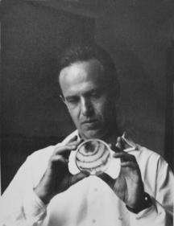
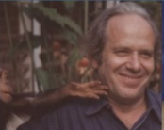

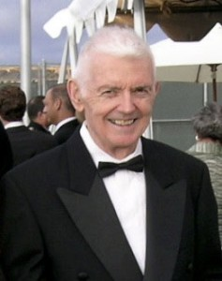
Distance Matrix Methods
Luidgi L. Cavalli-Sforza
Anthony W.F. Edwards
1967
Walter M. Fitch
Emanuel Margoliash

Slide 52
Outline
Transforming Distance Matrices into Evolutionary Trees
Toward an Algorithm for Distance-Based Phylogeny Construction
Additive Phylogeny
Ultrametric Evolutionary Trees (UPGMA reconstruction)
The Neibour-Joining Algorithm
Using Least-Squares to construct Distance-Based Phylogenies

Slide 53
Modeling Speciations
Researches often assume that all internal nodes correspond to speciations, where one species splits into two.

Slide 54
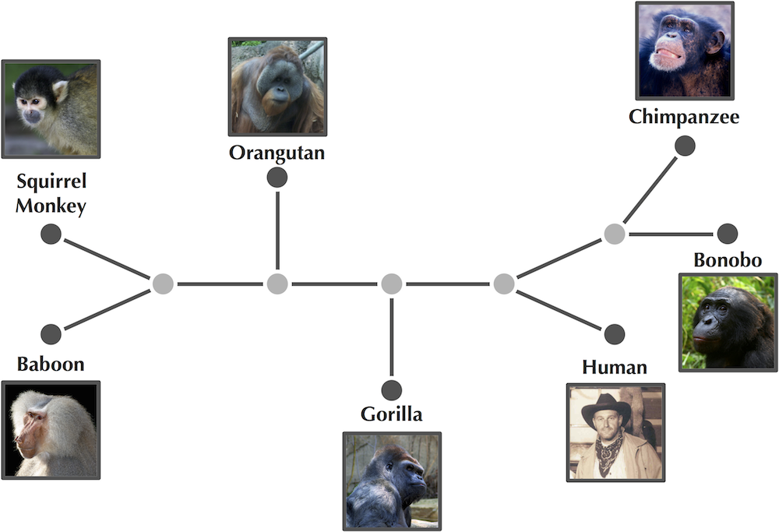
Modeling Speciations
In computer science, a binary tree is a tree data structure in which each node has at most two children, which are referred to as the left child and the right child.
Unrooted binary tree: every node has degree 1 or 3.
We need to place limits on the internal nodes of the tree: every internal node needs to have degree 3.
Progressing from the root to a leaf, every time we encounter an internal node, the tree splits into two pieces.

Slide 55
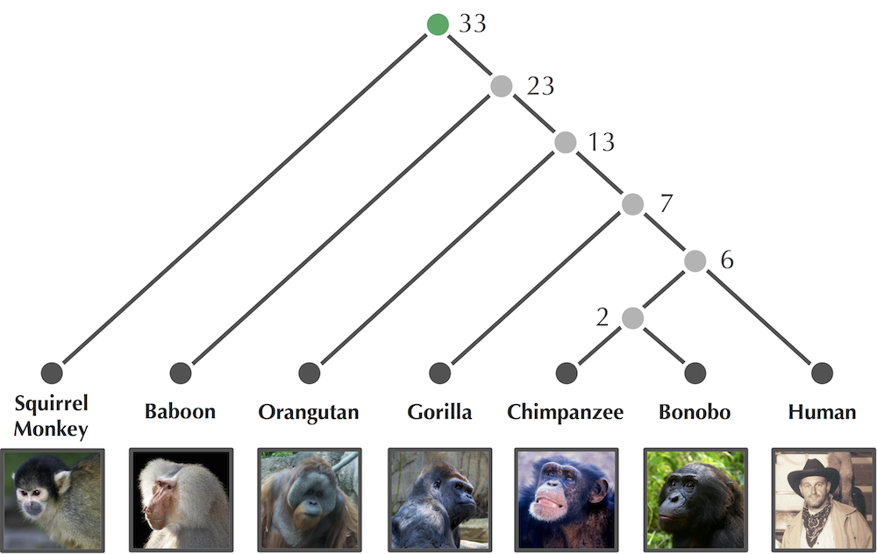
Modeling Speciations
Rooted binary tree: an unrooted binary with a root (of degree 2) on 1 of its edges.
Placing a root on the squirrel monkey's limb results in a rooted binary tree.
The number at each node corresponds to the number of million years ago that the divergence at this node occurred.

Slide 56
Ultrametric Trees
Molecular clock: assigns ages to each node in the tree (age of leaves=0)
Our goal: to design a heuristic that models a "molecular clock" that assigns each node an age.
The age of an internal node corresponds to how long ago the speciation event represented at that internal node occurred.
Then we need to assign ages to the internal edges.

Slide 57
Ultrametric Trees
Edge weights: correspond to difference in ages on the nodes the edge connects.
10
10
33
6
23
Once we assign ages to the nodes of a rooted binary tree, we get the weights of the edges of this tree (here shown in red) simply by taking the difference between the ages.
13
1
7
6
2
2

Slide 58
Ultrametric Trees
Ultrametric tree: distance from root to any leaf is the same (i.e., age of root).
10
10
33
6
If we assign ages to the nodes of the tree, then it automatically implies that the tree is "ultrametric“.
23
13
1
7
6
2
2

Slide 59
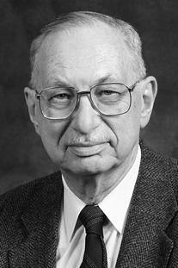
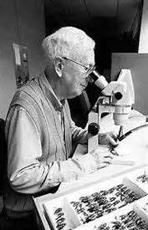
UPGMA: A Clustering Heuristic
UPGMA (Unweighted Pair Group Method with Arithmetic Mean) is a simple agglomerative (bottom-up) hierarchical clustering method.
&
Robert A. Sokal,
biostatistician
Charles D. Michener,
entomologist
Sokal R and Michener C (1958). "A statistical method for evaluating systematic relationships". University of Kansas Science Bulletin. 38: 1409–1438.

Slide 60
UPGMA: A Clustering Heuristic
1. Form a cluster for each present-day species, each containing a single leaf.
 | i | j | k | l
i | 0 | 3 | 4 | 3
j | 3 | 0 | 4 | 5
k | 4 | 4 | 0 | 2
l | 3 | 5 | 2 | 0
i
0
j
0
k
0
l
0
UPGMA constructs an evolutionary tree by clustering the species from the distance matrix into larger and larger clusters, beginning with single element clusters.

Slide 61
UPGMA: A Clustering Heuristic
2. Find the two closest clusters C1 and C2 according to the average distance
D_{avg}(C₁, C₂)= ∑_{i in C1, j in C2} D_{i,j}/|C₁|·|C₂|
Where |C| denotes the number of elements in C.
 | i | j | k | l
i | 0 | 3 | 4 | 3
j | 3 | 0 | 4 | 5
k | 4 | 4 | 0 | 2
l | 3 | 5 | 2 | 0
i
0
j
0
k
0
l
0
At each step it looks for the two closest clusters, according to the average distance among all pairs of elements taken from the two clusters. At this stage of the algorithm, we're dealing with single element clusters, so if we're looking for the closest clusters, that's just the smallest element of the distance matrix, which corresponds to k and l.

Slide 62
UPGMA: A Clustering Heuristic
3. Merge C₁ and C₂ into a single cluster C.
 | i | j | k | l
i | 0 | 3 | 4 | 3
j | 3 | 0 | 4 | 5
k | 4 | 4 | 0 | 2
l | 3 | 5 | 2 | 0
{k,l}
i
0
j
0
k
0
l
0
Once the two closest clusters C1 and C2 are found, we can merge them into a single cluster, C.
Here we put k and l into a cluster together because they're the closest.

Slide 63
UPGMA: A Clustering Heuristic
4. Form a new node for C and connect to C₁ and C₂ by an edge. Set age of C as D_{avg}(C₁, C₂)/2.
 | i | j | k | l
i | 0 | 3 | 4 | 3
j | 3 | 0 | 4 | 5
k | 4 | 4 | 0 | 2
l | 3 | 5 | 2 | 0
{k,l}
1
1
1
i
0
j
0
k
0
l
0

Slide 64
UPGMA: A Clustering Heuristic
5. Update the distance matrix by computing the average distance between each pair of clusters.
 | i | j | {k,l}
i | 0 | 3 | 3.5
j | 3 | 0 | 4.5
{k,l} | 3.5 | 4.5 | 0
{k,l}
1
1
1
i
0
j
0
k
0
l
0

Slide 65
UPGMA: A Clustering Heuristic
6. Iterate until a single cluster contains all species.
 | i | j | {k,l}
i | 0 | 3 | 3.5
j | 3 | 0 | 4.5
{k,l} | 3.5 | 4.5 | 0
{i,j}
1.5
1
1.5
1.5
1
1
i
0
j
0
k
0
l
0

Slide 66
UPGMA: A Clustering Heuristic
6. Iterate until a single cluster contains all species.
2
0.5
1
 | {i,j} | {k,l}
{i,j} | 0 | 4
{k,l} | 4 | 0
1.5
1
1.5
1.5
1
1
i
0
j
0
k
0
l
0

Slide 67
UPGMA: A Clustering Heuristic
6. Iterate until a single cluster contains all species.
2
0.5
1
 | {i,j} | {k,l}
{i,j} | 0 | 4
{k,l} | 4 | 0
1.5
1
1.5
1.5
1
1
i
0
j
0
k
0
l
0

Slide 68
UPGMA: A Clustering Heuristic
6. Iterate until a single cluster contains all species.
2
0.5
1
1.5
1
1.5
1.5
1
1
i
0
j
0
k
0
l
0

Slide 69
UPGMA: A Clustering Heuristic
Form a cluster for each present-day species, each containing a single leaf.
Find the two closest clusters C1 and C2 according to the average distance
D_{avg}(C₁, C₂)= ∑_{i in C1, j in C2}D_{i,j}/|C₁|·|C₂|
Where |C| denotes the number of elements in C.
Merge C₁ and C₂ into a single cluster C.
Form a new node for C and connect to C₁ and C₂ by an edge. Set age of C as D_{avg}(C₁, C₂)/2.
Update the distance matrix by computing the average distance between each pair of clusters.
Iterate until a single cluster contains all species.

Slide 70
UPGMA Doesn’t “Fit” a Tree to a Matrix
2
0.5
1
 | i | j | k | l
i | 0 | 3 | 4 | 3
j | 3 | 0 | 4 | 5
k | 4 | 4 | 0 | 2
l | 3 | 5 | 2 | 0
1.5
1
1.5
1.5
1
1
i
0
j
0
k
0
l
0
The goal of UPGMA is not to fit a distance matrix, but to provide a reliable method that always can construct an ultrametric tree, regardless of what the input data is.

Slide 71
UPGMA Doesn’t “Fit” a Tree to a Matrix
2
0.5
1
 | i | j | k | l
i | 0 | 3 | 4 | 3
j | 3 | 0 | 4 | 5
k | 4 | 4 | 0 | 2
l | 3 | 5 | 2 | 0
1.5
1
1.5
1.5
1
1
i
0
j
0
k
0
l
0
The tree produced by UPGMA can't possibly fit this matrix, because the matrix is non-additive.
For example, the distance from i to l is 3 in the distance matrix, but 4 according to the UPGMA tree.

Slide 72
Exercise Break
Below is a distance matrix D. If C1 is the cluster containing i and k, and C2 is the cluster containing j and l, compute D(C1, C2).

Slide 73
Exercise Break
Reconstruct phylogenetic tree from the following distance matrix using UPGMA approach:
OTUS A B (CD) E B 6 (CD) 29 31 E 24 26 32 F 30 28 15 30
What would be the topology of this tree? (Parentheses indicate the order of grouping):
((EAB(CDF)); b) (EA(B))(CD)F); c) ((AB)(CD)F)E; d) (E(AB))((CD)F)
If in the previous exercise dF(CD) – d(CD)=9, what is the distace of the both taxons C and D to their most recent common ancestor?
a) 3,0 ; b) 1,5 ; c) 1,0 ; d) 2,0

